Slide 1


Slide 2


Best Practices in Social Media - Agenda
Social Media Intro/Update
Staying Connected with Fans
Ideas to Fill an Arena/Stadium
Attracting Sponsors
Using Paid Advertising Methods
A Lean Team Formula
Time for Your Questions

Slide 3
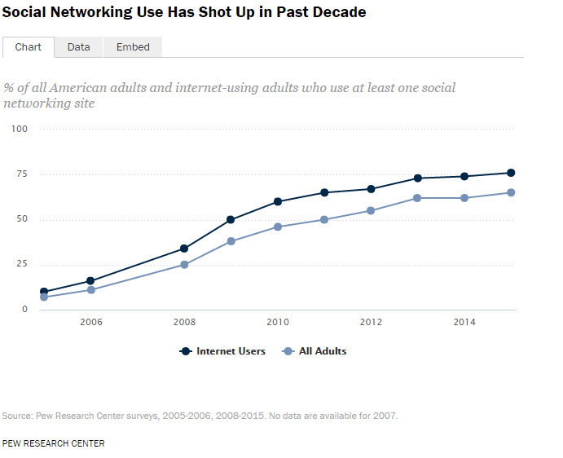
General Social Stats
76% of internet users use at least one social networking site
65% of adult users
This is compared to .03% use in No. Korea

Slide 4
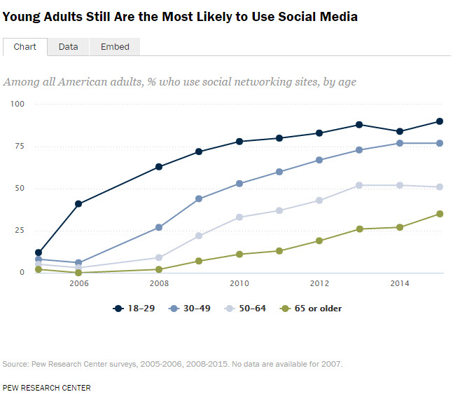
Differences Among Age Groups
90% of adults 18 – 29 use social media
77% of adults 30 – 49
51% of adults 50 – 64
35% of adults 65+

Slide 5
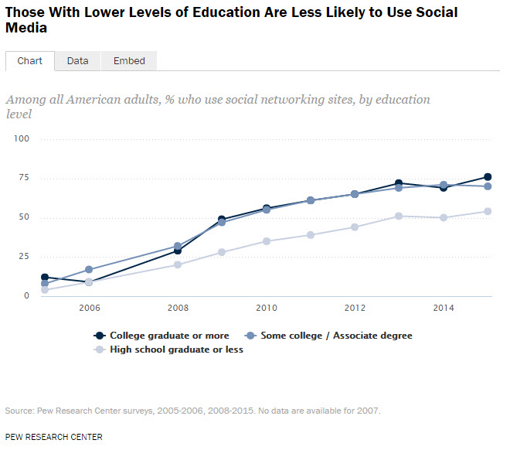
Differences Among Levels of Education
76% of those who are College graduate or higher use social media
70% of those with some College or an Associates degree
54% of those who are High School graduate or less

Slide 6
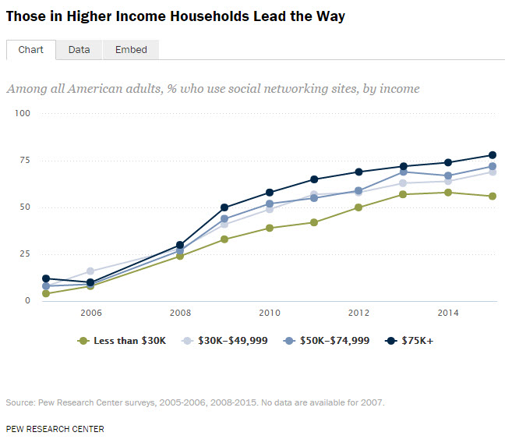
Differences Among Income Levels
78% of those who earn $75k+ use social media
72% of those who earn $50k-$74,999
56% of those who earn $30k-$49,999

Slide 7
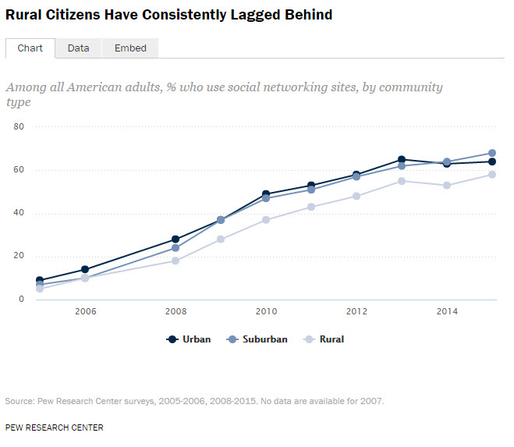
Differences Among Geos
68% of Suburban adults use social media
64% of Urban adults
58% of Rural adults

Slide 8
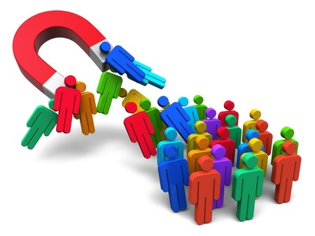
More Social Stats
52% of social media use from mobile phone
(Up 6% since Jan 2015)
1.7 hours spent on social media daily
(Compared to 3.3 hours watching TV)
Top platform is Facebook, followed by Instagram, Twitter and Snapchat
Source: SmartInsights.com Global Study

Slide 9

Facebook Platform Stats & New Features
~172 million daily active users in US/Canada
~156 million daily mobile active users
Live video streams now available!
For examples go to facebook.com/livemap
Advertise on Facebook & Instagram even if you don’t have an Instagram account

Slide 10
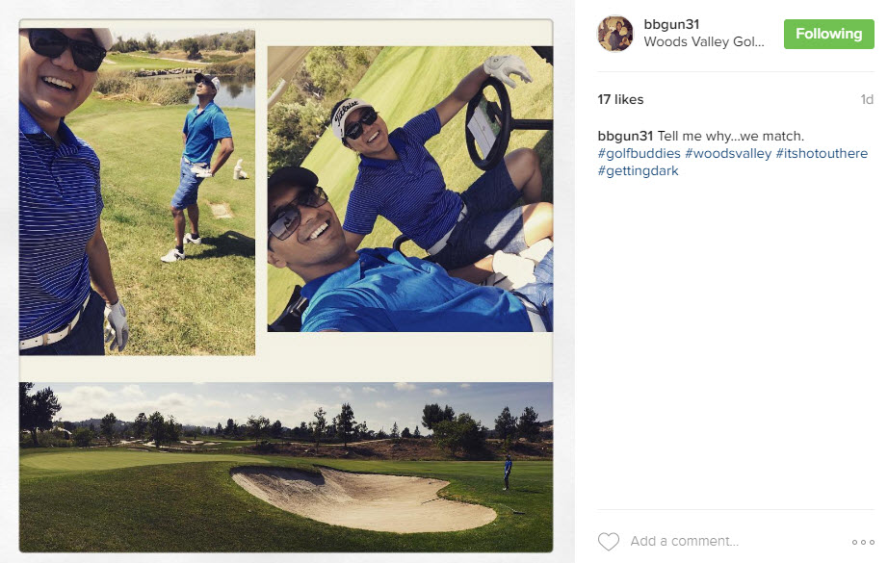
Instagram Platform Stats & New Features
~100 million monthly active users in US
~20 million photos shared daily
Video views growing significantly
3.5 billion likes across entire network daily
60-second videos here (or coming soon)
Hyperlapse only for iOS
Boomerang & Collage work on iOS/Android

Slide 11
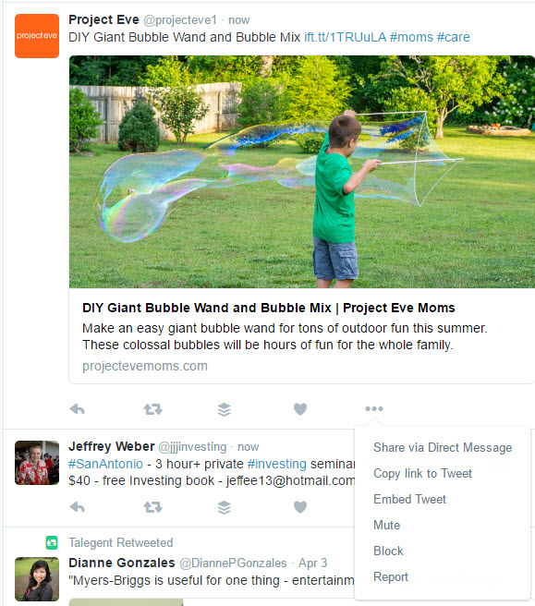
Twitter Platform Stats & New Features
~65 million monthly active users in US
~54 million mobile active users
Changes in 140-character limit coming!
Retweet or Quote your own Tweets
Direct Messages can exceed 140
Send Tweets as Private messages
Broadcast live video via Periscope

Slide 12
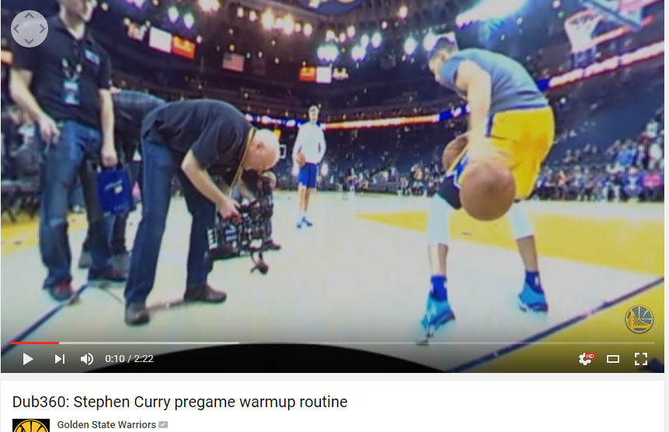
YouTube Platform Stats & New Features
~200 million users in US
Reach of 18-34 year olds
More than ½ of views coming from mobile
Ave viewing session on mobile >40 minutes
Hundreds of millions of hours watched daily
Improved mobile discovery of likeable videos
Upload 360 degree videos

Slide 13
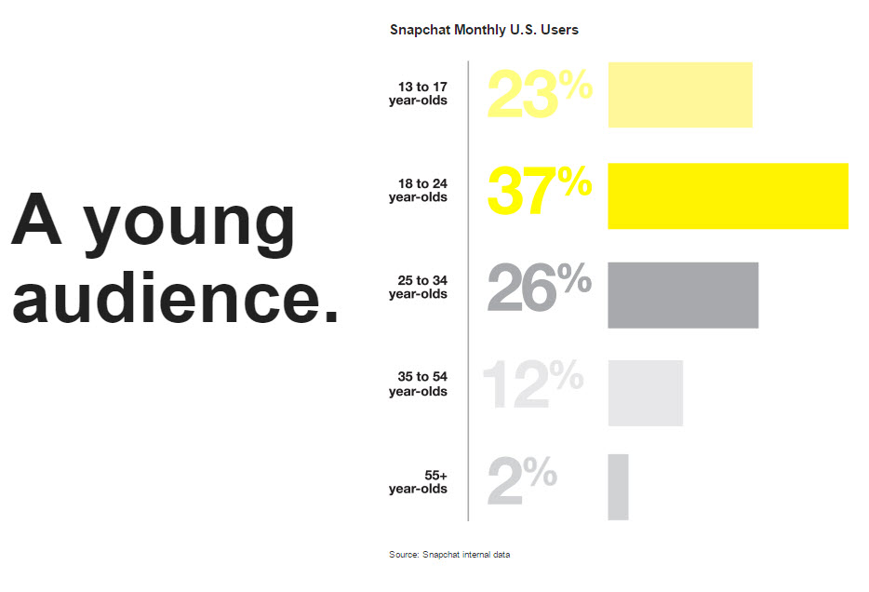
Snapchat Platform Stats & News
Reports over 100 million daily active users and over 10 billion video views a day
That’s more views than Facebook!
Millenials account for 7/10 of Snapchatters
Snapchat made a deal with the Olympics!

Slide 14
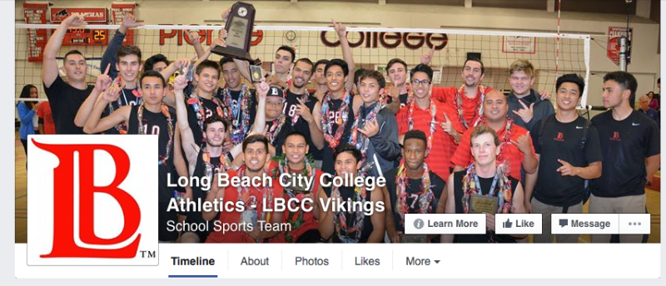
Staying Connected With Fans – LBCC Vikings
What they do right
Post good pics and collages
Create their own unique graphics
Post regularly on FB & Twitter
Post in advance of games
Recognize past players doing great things
Social network links clearly on website

Slide 15
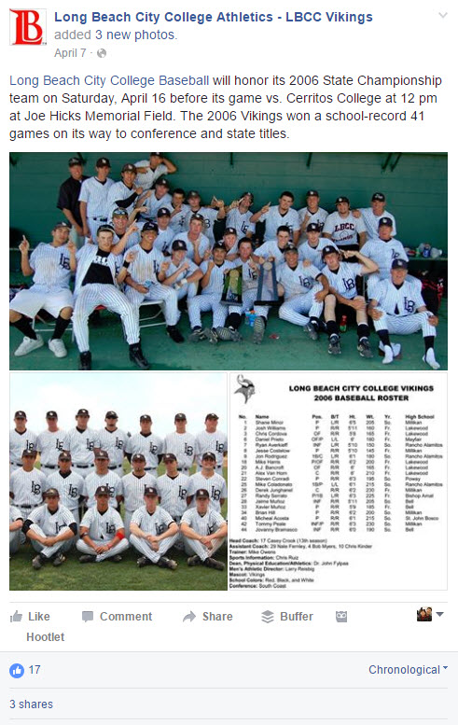
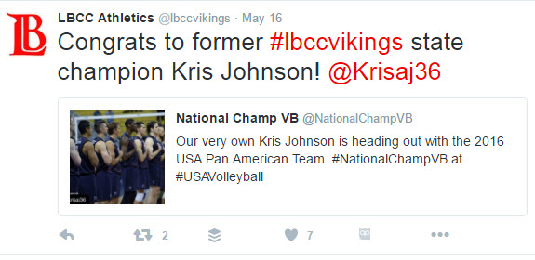
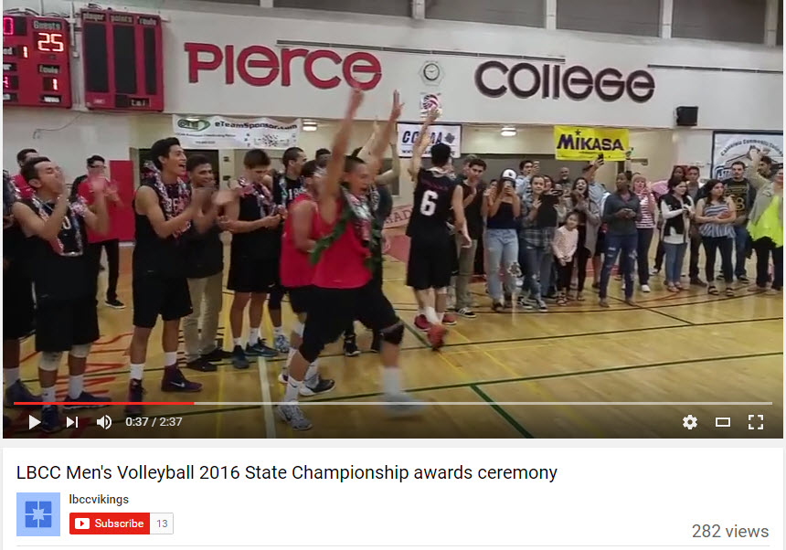
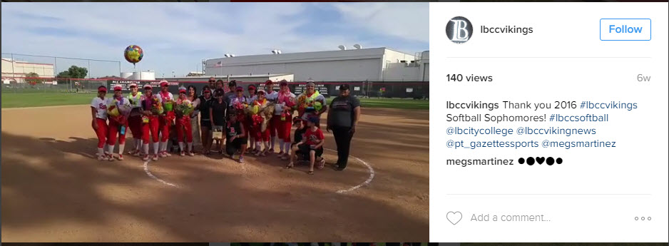
LBCC Vikings – Some Examples

Slide 16
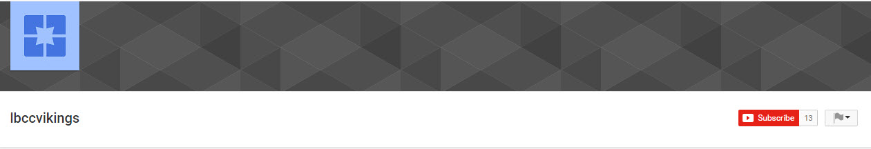
Staying Connected With Fans – LBCC Vikings
What they could do better
Reply to comments on Facebook
Post videos natively to Facebook & Boost some posts
Post more videos on YouTube
Upload Channel art to YouTube
Get going with Snapchat
Get main college FB acct to post their content once in a while

Slide 17
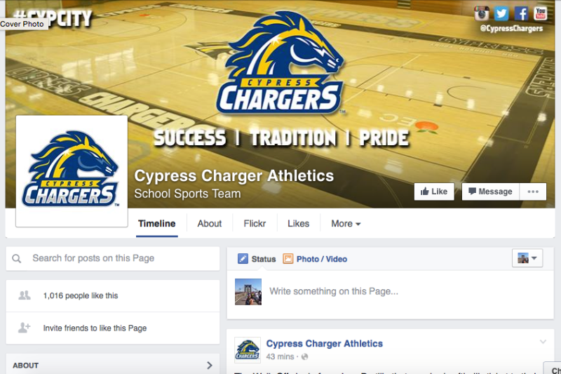
Staying Connected With Fans – Cypress Chargers
What they do right
Use YouTube and have subscribers!
Create their own unique graphics
Post regularly on FB & Twitter
Post lots of video everywhere
Have their own hashtag #cypcity
Social network links promoted well

Slide 18
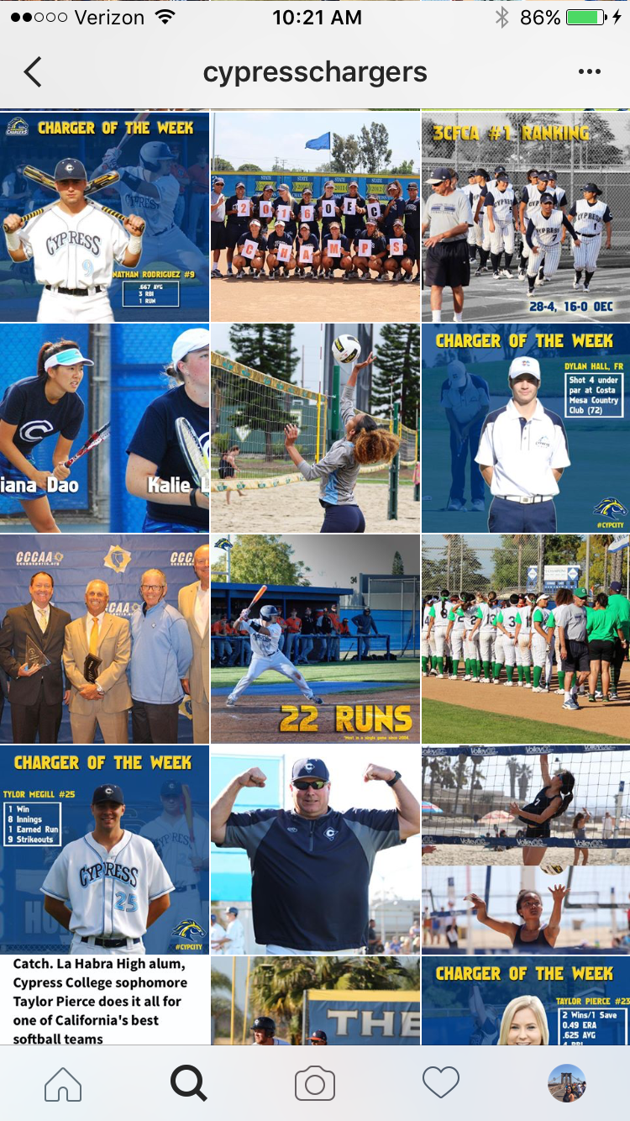
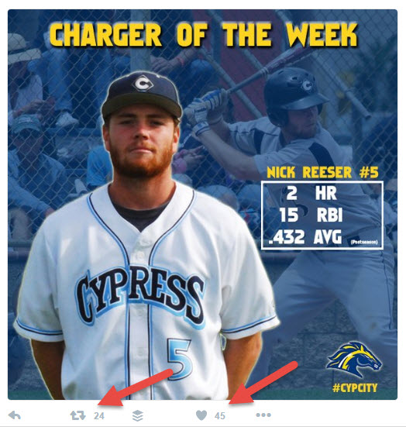
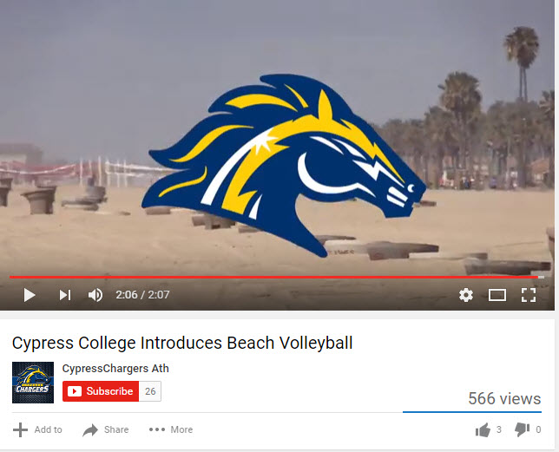
Cypress Chargers – Some Examples

Slide 19
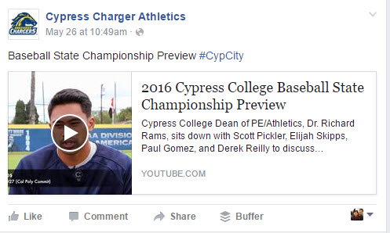
Staying Connected With Fans – Chargers
What they could do better
Reply to comments on Facebook
Post videos natively to Facebook & Boost
Use more hashtags on Twitter #cypress #baseball
Use YouTube Cards to promote channel subscriptions
Get going with Snapchat
Follow more people back on Instagram and Twitter

Slide 20
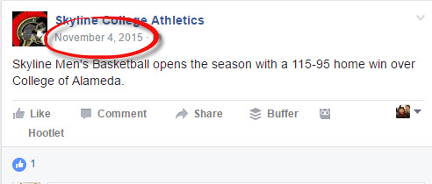
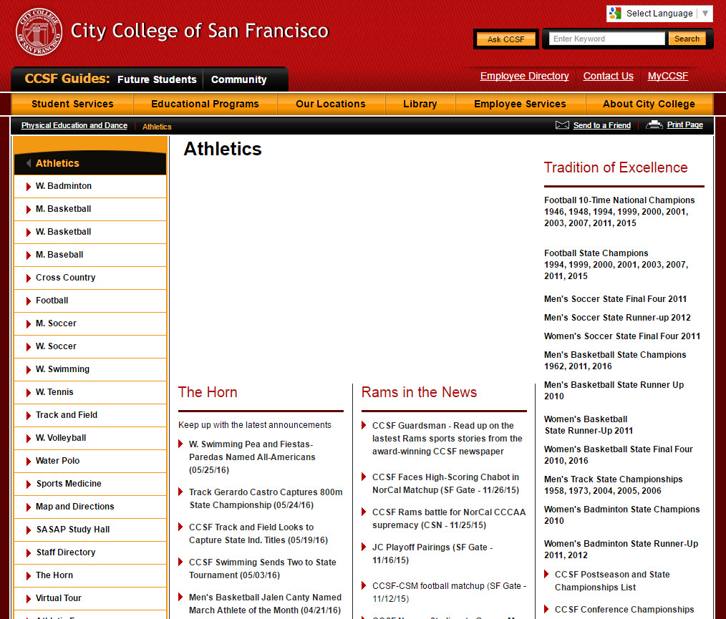
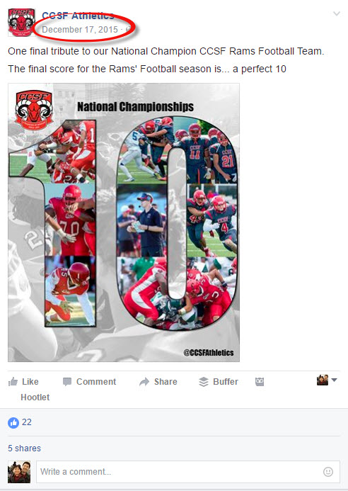
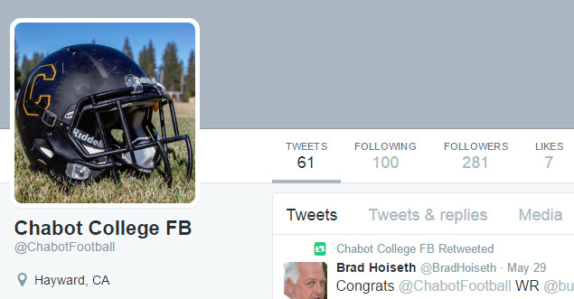
What Not To Do

Slide 21
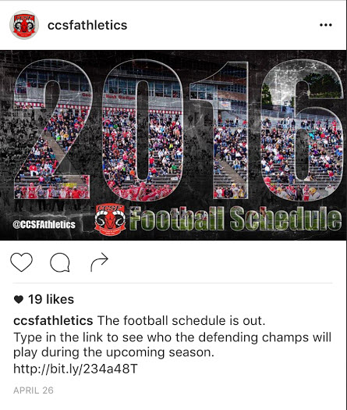
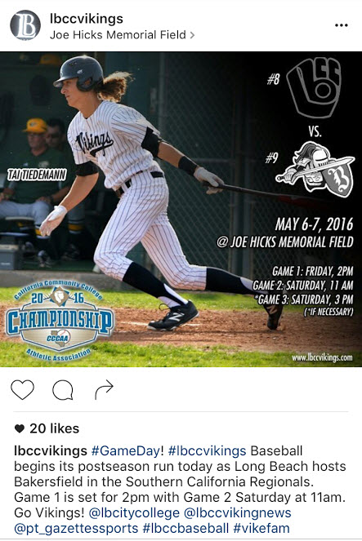
Ideas To Fill An Arena/Stadium
A few things to consider
Post early and often
Include links to ticketing site
Create custom graphics
Ask for Shares and Retweets
Work a campaign across all your channels including email
Use paid advertising on Facebook & Instagram

Slide 22
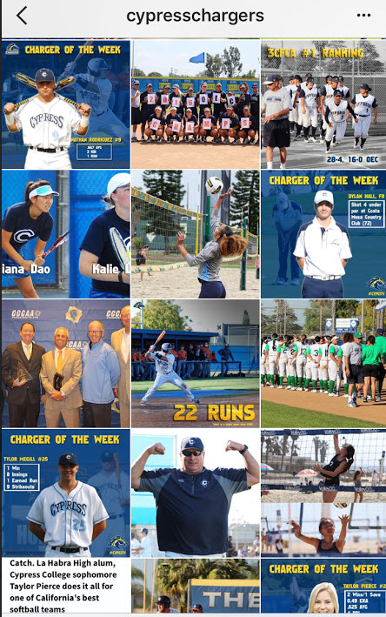
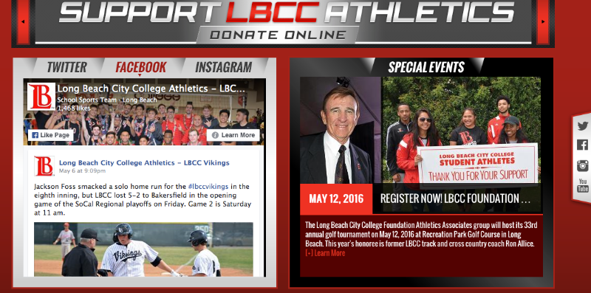
Ideas To Attract Sponsors
A few things to consider
Have a strong following across channels
Look active across multiple sports
Look slick
Share some sponsor content
Post regularly
Ask?

Slide 23
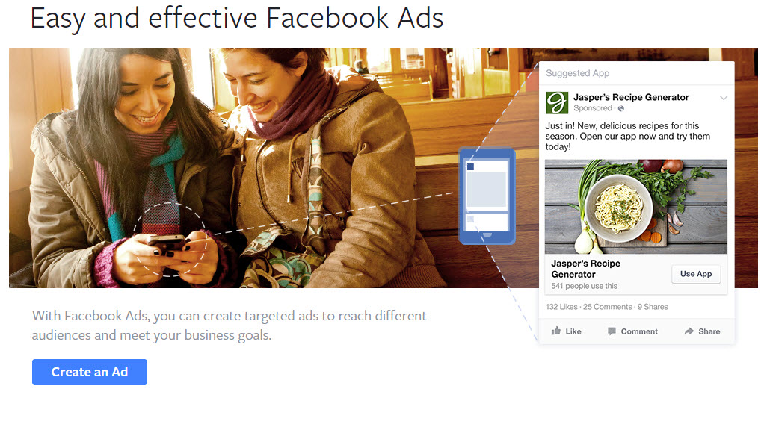
Using Paid Advertising
I recommend Facebook
There is plenty of helpful info from Facebook
It’s connected to Instagram for a double hit
Advertise for just dollars a day
There are great targeting options
*facebook.com/advertising

Slide 24
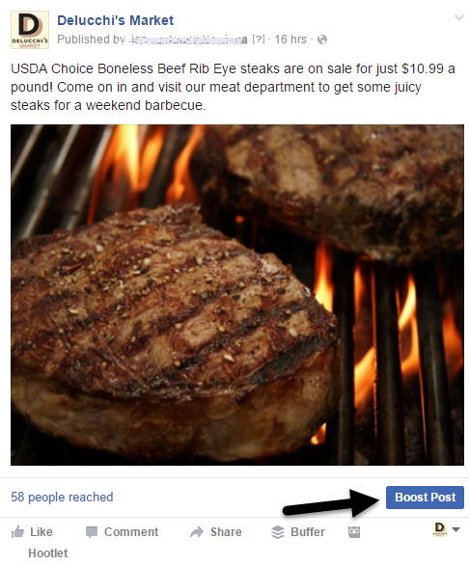
The Easiest Ad Is a Boosted Post
Post, then click the Blue Button
After that you’ll choose your target
Set a budget and duration
Then, Boost
*You can boost a posted video, too

Slide 25
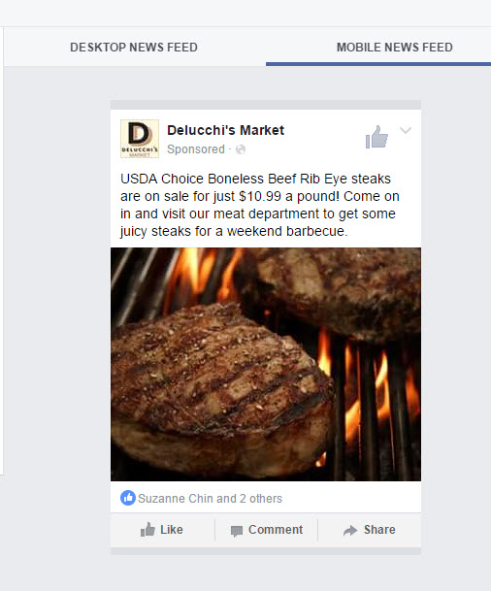
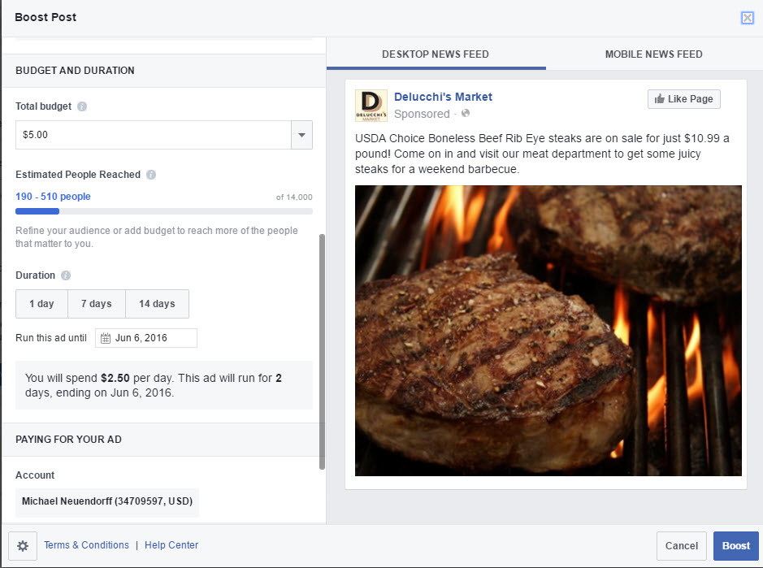
How It Looks Behind the Button

Slide 26
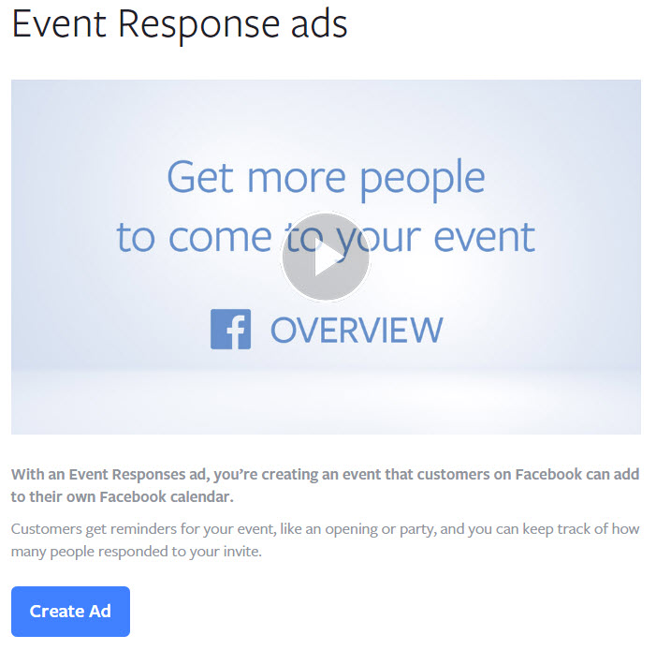
Consider Event Ads for Big Game Draw
You’ll start by creating a Facebook Event
Then you can pay to promote it
You can select age, gender, interests
Set a budget and duration
It’s simple!

Slide 27
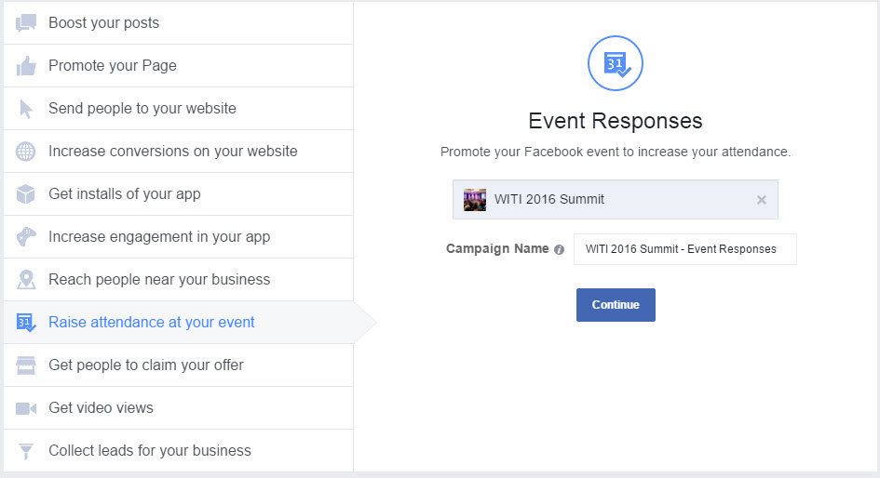
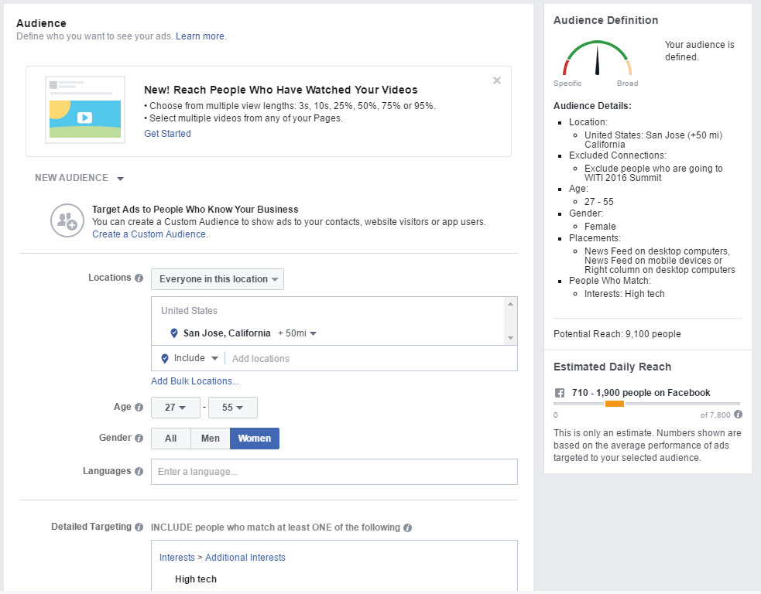
How It Looks Behind the Button

Slide 28

Some Advertising Tips
It’s critical to use paid ads along with organic
Spend an hour or two and go through Facebook’s info on ads
Spend less if necessary, but don’t give up
The more active your Page, the better your advertising will work. Activity begets activity.

Slide 29
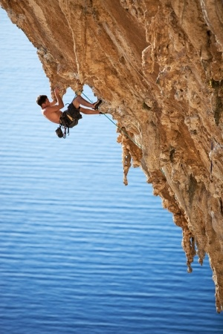
Some Advanced Advertising Tips
Run multiple campaigns, try different demographics and interests/behaviors, test and refine
Target fans of the general college FB Page
Advertise to people who visit your website by using a pixel supplied by Facebook
If you have an email list of a 1,000 or more, upload it to Facebook for a Lookalike audience

Slide 30

Plan Now To Use Snapchat In The Fall
Don’t let this opportunity pass you by
It is growing like crazy & replacing Twitter
Your students will love that you’re on it
Create a Story on Big Game days
Send fun Snaps to followers on other days
Consider trying a highjack 1x a month with a star player on one of your teams

Slide 31

The Pac 12’s Already On Snapchat
All the cool schools are doing it
CalAthletics
uclatheden
cubuffs_snap
gostanford
usc_athletics
And Utah, Washington & Oregon too

Slide 32
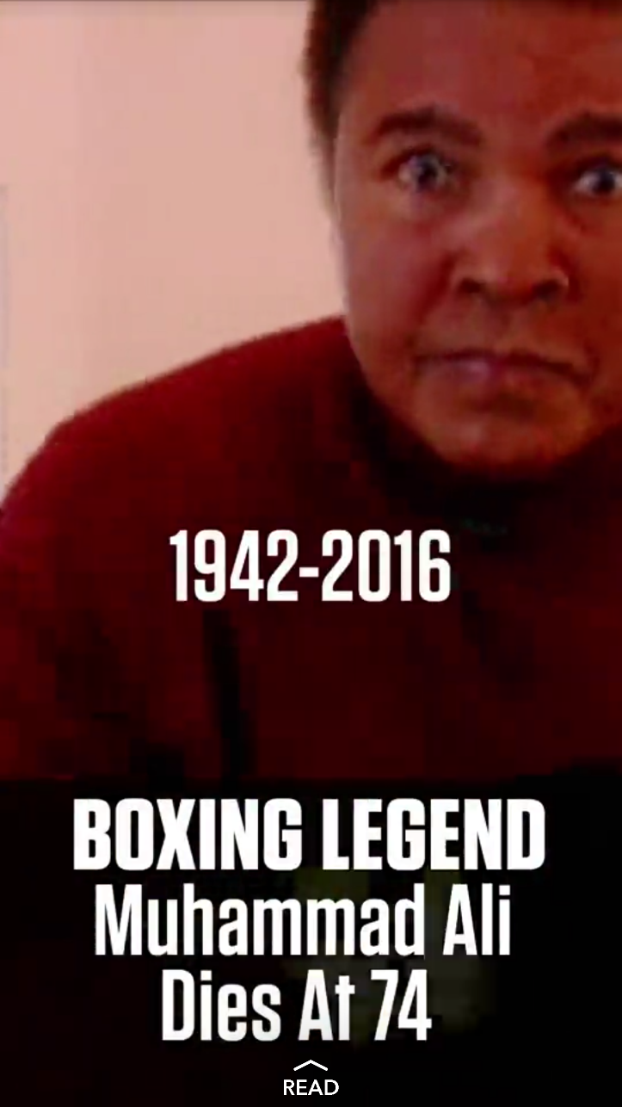
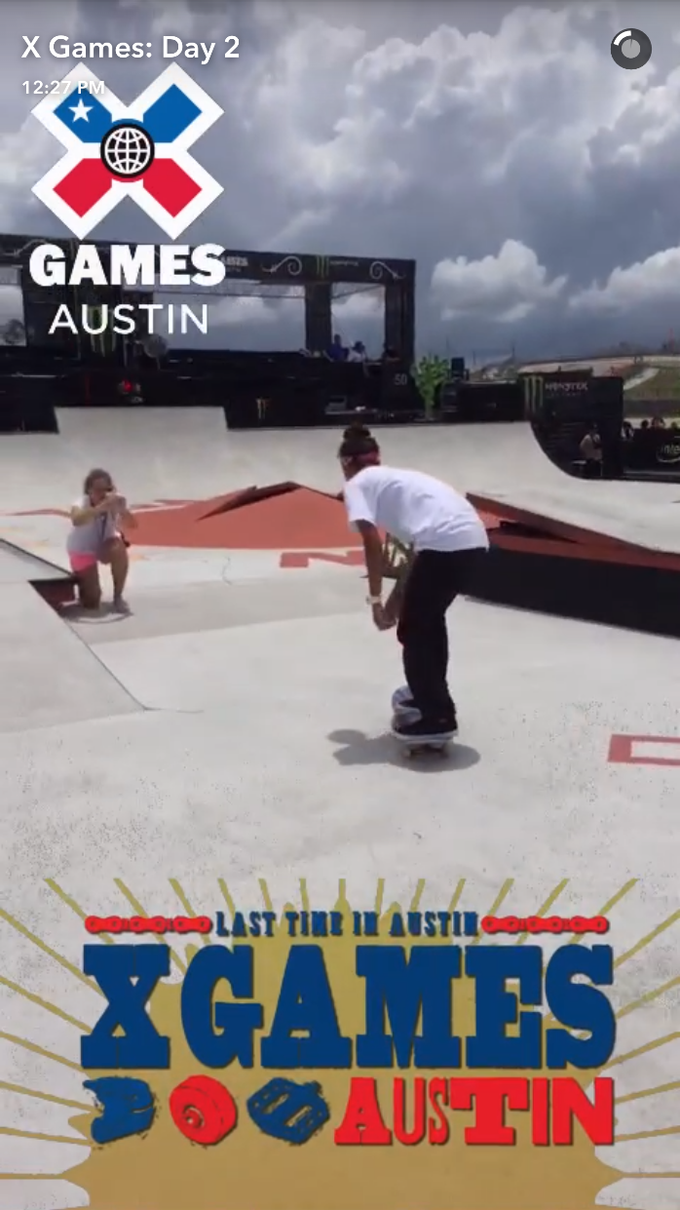
What Snaps Look Like
They are always vertical
They take up the whole screen
They can be images or videos
They can have text and image overlays
You can design your own On-Demand Geofilters

Slide 33

How to Get Followers on Snapchat
Download the app on a mobile phone to create an account
Promote your account on other networks
Post about it on your website
Talk about it via email
Use your Snapcode as your profile pic for other accounts on Facebook or Twitter

Slide 34

The Lean Formula
If you just have 1-2 people on the job
Focus on Facebook, Instagram & Snapchat
Post 3-4x a week on each one
Boost one key FB post per week
Advertise big games on Facebook for a week
Post at least 1 video per week
When slow, post videos on YouTube channel

Slide 35

Resources & Tools I Recommend
Some are new, some are old
Buffer for scheduling posts on FB, Twitter
Giphy.com – gifs are in the house!
Adobe Spark – for graphics & videos
123rf.com for royalty free photos
Constant Contact Social Campaigns
Social Media Examiner for the best free edu

Slide 36
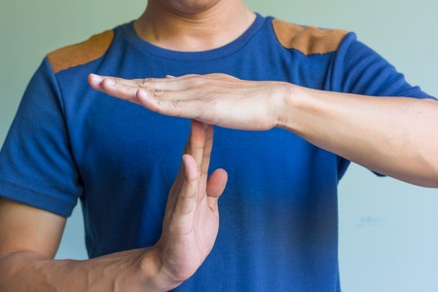
Timeout For Your Final Questions

Slide 37

Final Tips
Don’t stay in your comfort zone
Social is always changing. Run with it.
Try to never be predictable
Invest in great graphics & use gifs
Embrace citizen journalism
Don’t watch the conversation
Be part of the conversation

