Slide 1



Student-Athlete Scorecard

Slide 2
Goals
Look to adopt a template for the CCCADA website
Establish a cohort for colleges
  Conference
  Regional
  State-wide
Discuss institutionalizing the data
  Conference Program Review?

Slide 3
Useful Metrics…
GPA
  Vs. institutional non-student/athletes
    Currently only comparison between institutional S/A’s and non-S/A’s available
  Vs. state-wide student-athletes
  Vs. state-wide non-student athletes
Units attempted
Units completed
Successful units completed
% passing transfer level English
% passing transfer level English in 2 years
% passing transfer level math
% passing transfer level math in 2 years

Slide 4
Useful metrics (cont’d)…
Can include sub-populations
  Gender
  Ethnicity
  Full-time vs. part-time

Slide 5
How to use the data
Board Presentations
Academic Senate Presentations
Executive Administration presentations
Deans Council presentations

Slide 6
Purpose of the data
Highlight strengths of your student-athletes
Highlight deficiencies
  Use deficiencies to strengthen your program
    Resource allocation requests
Compare internally as well as with similar size institutions

Slide 7
Examples of Reports:
Metric |  | S/A | Non S/A | State S/A | State non-S/A
GPA |  | 2.69 | 2.59 | 2.65 | 2.58
Units Attempted |  | 30.87 | 13.9 | 28.49 | 11.98
Successful Units Completed |  | 22.04 | 11.77 | 21.36 | 10.05
Avg. Course Success Rate |  | 72.28 | 67.24 | 76.54 | 68.37
Transferred to a 4 year institution |  | 24% | 8% | 28% | 9%
Received Associate Degree |  | 22% | 12% | 27% | 13%
Remediation
% having passed transfer English |  | 77% | 71% | 82% | 74%
Completed transfer English in 2 years |  | 61% | 49% | 58% | 43%
% having passed transfer math |  | 39% | 36% | 59% | 51%
Completed transfer math in 2 years |  | 19% | 14% | 32% | 22%

Slide 8
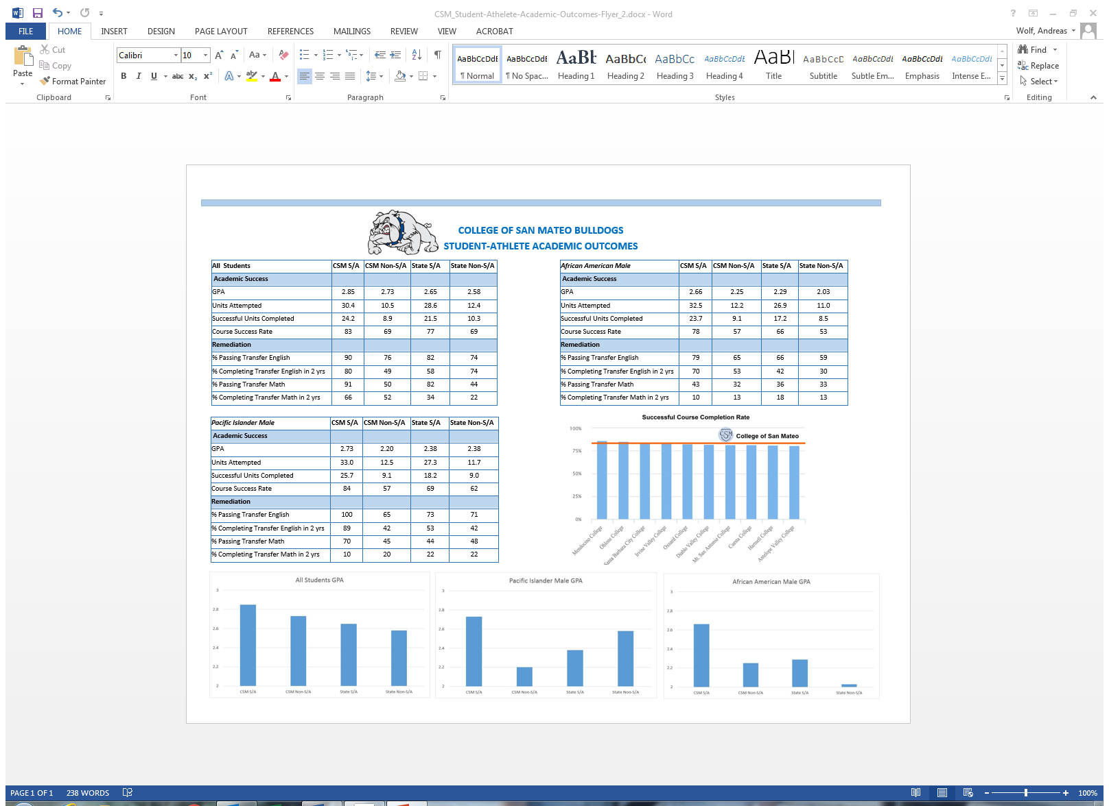

Slide 9
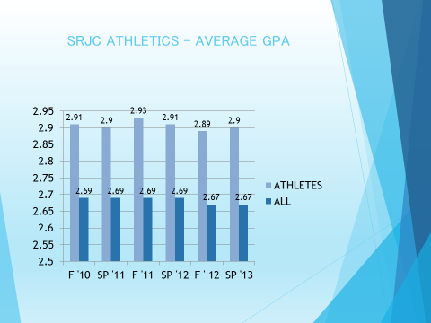
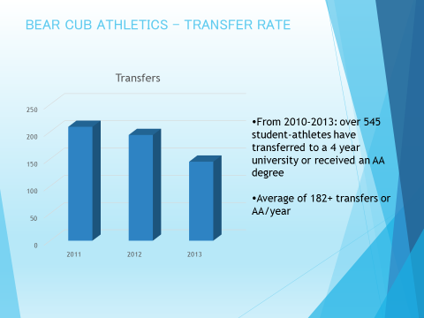
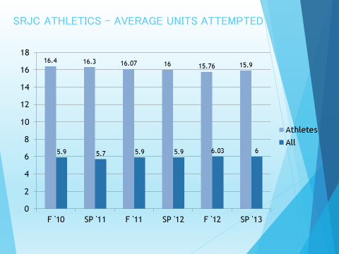
Example of reports…

Slide 10
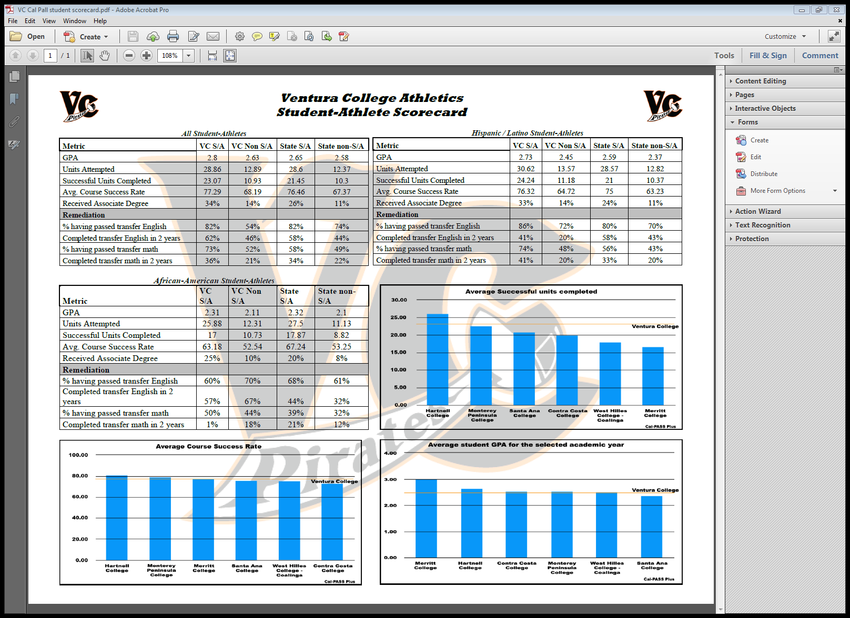

Slide 11
Questions to the Field…
(1) Use of a common template
  What would you like to see included
(2) Establishing cohort groups
  Conference?
  Regional?
  State-wide?
    Size of institution, location, etc.
(3) How do we institutionalize the data
  Progam Review?
  Other?

Slide 12
Other questions/comments
Your thoughts and input are important

